Slide 1
Lecture 6
Financing Baseline – Part 2
Open Learn Collection
Financial Modelling for Energy Transitions: MINFin, FinTrack & FinCoRE

Slide 2
Lecture Outline
Financial Modelling for Energy Transitions
 | Learning Objectives
Part 1 | High costs of capital as a barrier to the energy transition
Part 2 | Debt financing for renewables
Part 3 | Equity financing for renewables
Part 4 | Weighted Average Cost of Capital

Slide 3
Learning Outcomes
ILO1: Learn and understand how high costs of capital are acting as a barrier to the energy transition in developing countries
ILO2: Understand the risk factors contributing to the cost of commercial financing through debt
ILO3: Understand the risk factors contributing to the cost of financing from commercial equity investors
ILO4: Learn and understand what factors influence the capital structure for infrastructure infrastructure investments and how this influences the affordability of financing

Slide 4

High costs of capital as a barrier to the energy transition
Part 1

Slide 5
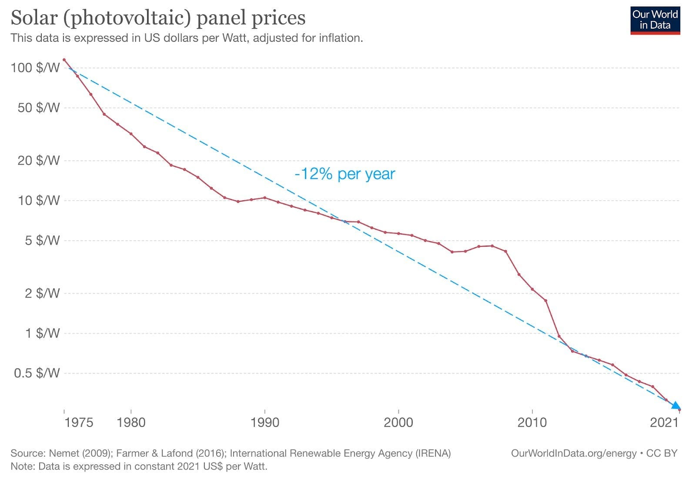
Costs of capital and the energy transition
Renewable technologies e.g., solar panels have experienced rapid reductions in cost over recent decades
Further price reductions will lead to their increasing cost competitiveness
The cost of capital will also needs to fall in many regions for cost competitiveness

Slide 6

Costs of capital and the energy transition
The cost of capital describes the terms of finance that an energy infrastructure project receives, from debt and equity investors
Low-carbon infrastructure projects (e.g., renewable generation such as onshore wind) typically have high upfront costs with low or minimal operating costs
Due to this investment profile, terms of finance (i.e. the cost of capital) has a strong impact on project viability

Slide 7
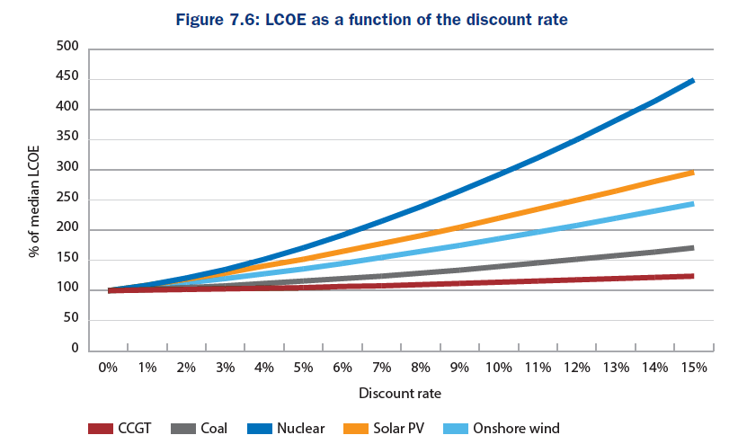
Costs of capital and the energy transition
Renewable breakeven electricity costs ( "levelised costs") particularly sensitive to the cost of capital
It is even more pronounced for nuclear, due to long lifetimes and high upfront costs

Slide 8
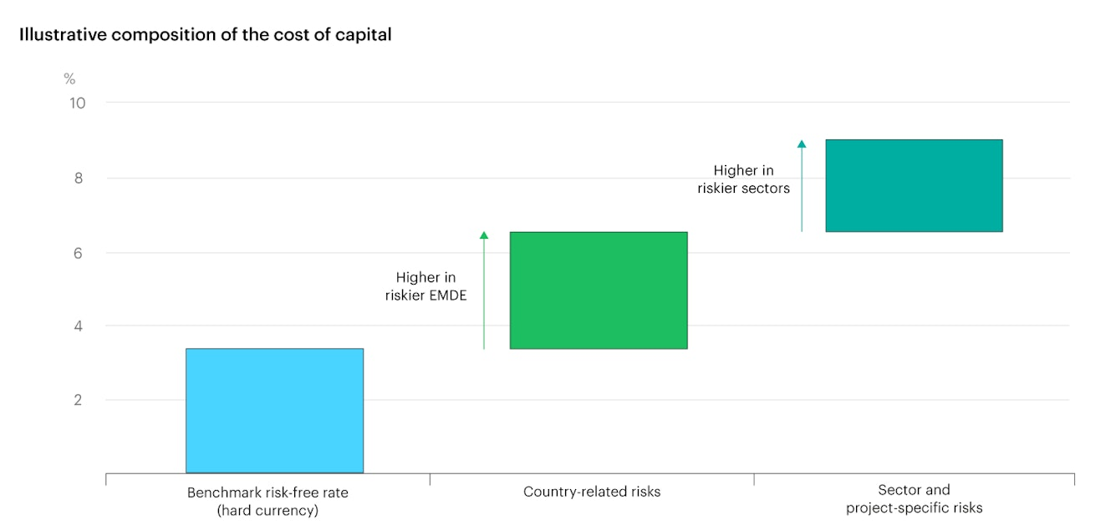
Costs of capital and the energy transition
The cost of capital for energy investments is influenced by various factors:
Risk free rates
Country level risks
Sector level risks
Project level risks
Costs of capital can be up to 2-3x higher in developing countries

Slide 9
Costs of capital and the energy transition
Sources of risk | Examples
Country risk | political risks, security, government stability, status & transparency of legal system
Financial and economic risk | economic growth, inflation, interest rates, currency & exchange rates
Policy, and regulatory risk | changes to tariff structures, subsidy regimes, permitting requirements
Technical and project risk | construction risk, technological risk, environmental risk, operational / performance risk
Market risk | future demand and supply balance, market pricing risks, fuel prices, subsidy prices

Slide 10
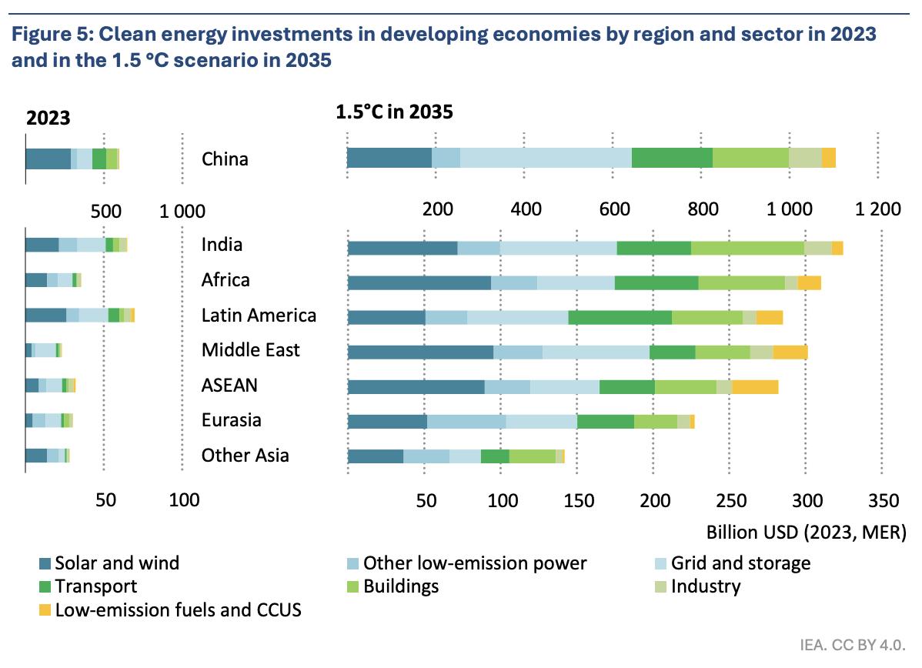
Costs of capital and the energy transition
Addressing factors causing high costs of capital will be key to scaling up investment in developing countries
Will require policy reform and international support (e.g., grants & concessional finance)
Concessional financing will need to at least triple by 2030

Slide 11
Debt financing for renewables
Part 2

Slide 12
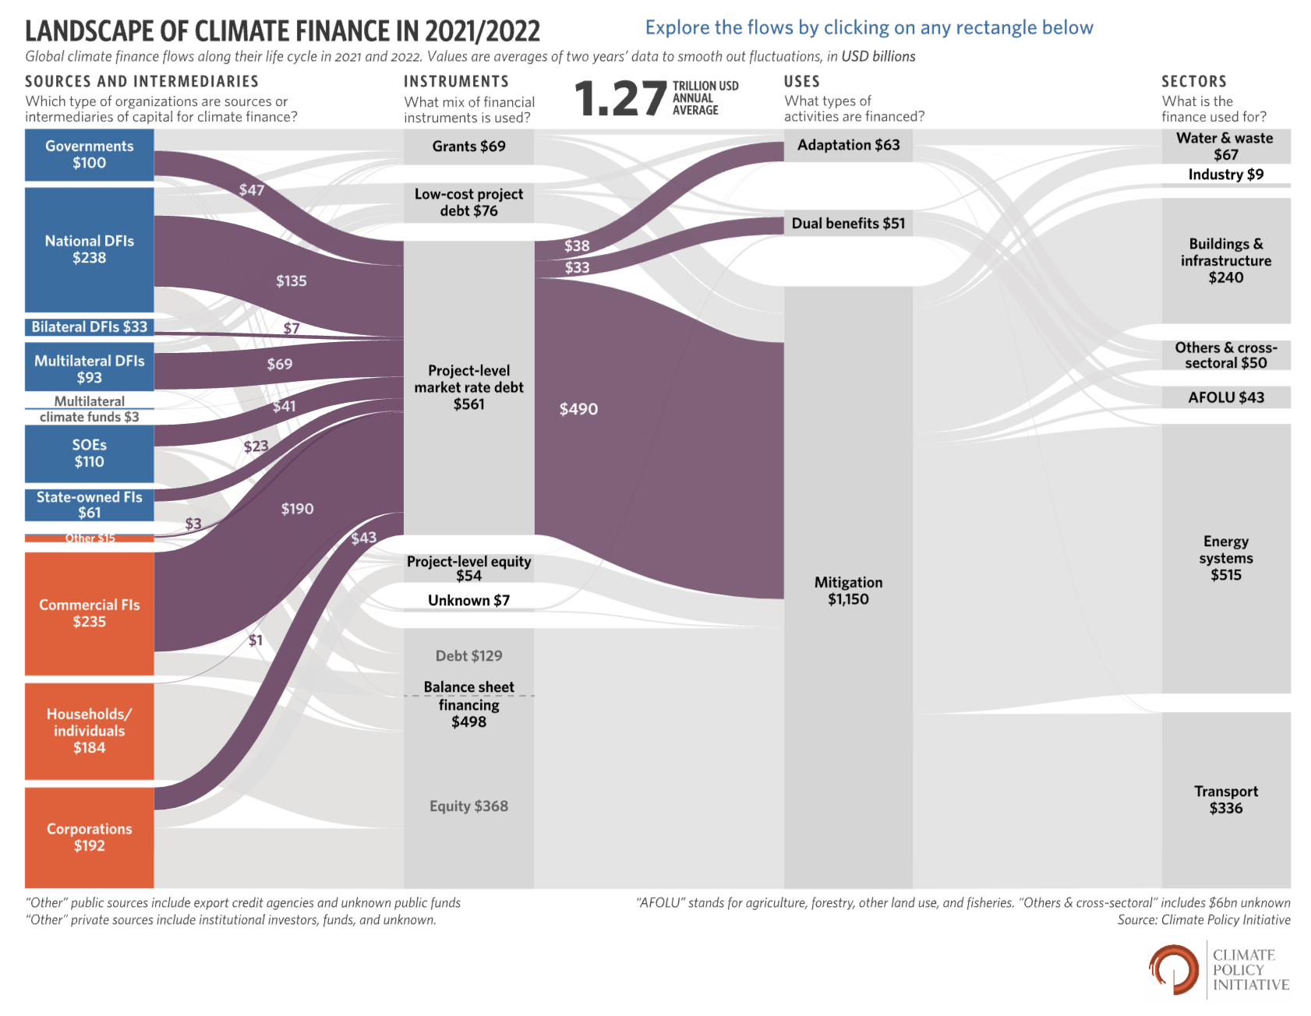
Debt financing for renewables
Debt financing plays an important role in global climate financial flows
In debt financing, capital is exchanged for specified loan repayments
Debt financing can either be on or off balance sheet

Slide 13
Debt financing for renewables
Debt (and equity) financing can take place either on- or off- balance sheet, depending on project context
On-balance sheet: projects are financed by a company and the debt taken on to finance it shows up on its balance sheet
Off-balance sheet: a separate financing structure is set up for the project, with debt and equity repaid from the project cashflow
Off-balance sheet financing structures typically allow for higher shares of debt and reduces the risks in the event of project failure

Slide 14

Debt financing for renewables
Cost of debt (Rd) can be disaggregated into several components:
Risk-free rate (Rff)
Country risk premium (Rcc)
Technology risk premium (Rtt)
$$Rd=Rff+Rcc+Rtt$$

Slide 15
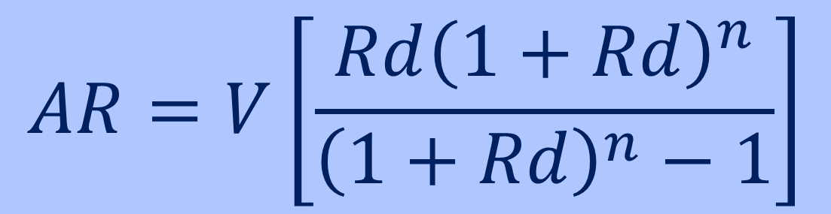
Debt financing for renewables
Annual loan repayment (AR) is based on several components:
Principal (V)
Interest rate (Rd)
Grace period (g)
Maturity (m)
Repayment periods (n=m-g)
$$AR=V\left[\frac{Rd{\left(1+Rd\right)}^{n}}{{\left(1+Rd\right)}^{n}−1}\right]$$

Slide 16

Debt financing for renewables
Debt providers investing internationally are exposed to exchange rate fluctuations, which can affect the value of loan repayments
It is especially an issue in developing countries, where inflation and economic instability can drive volatile exchange rates
International debt is typically denominated in "hard" currencies e.g., the US dollar to avoid exchange rate risks

Slide 17
Cost of Commercial Equity
Part 3

Slide 18
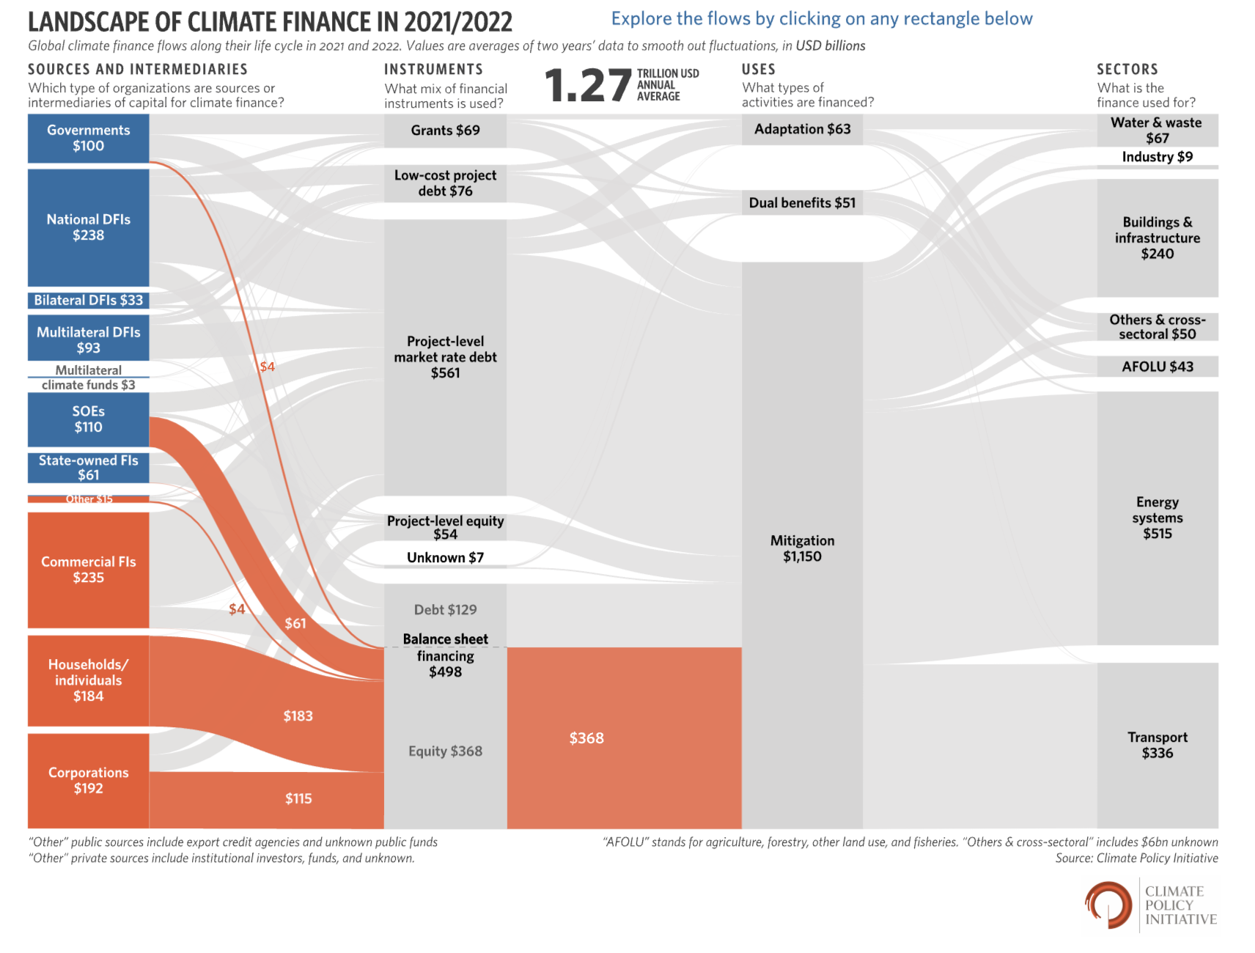
Equity financing for renewables
Equity financing plays a smaller, but still important, role in climate financial flows
In equity financing, capital is exchanged for a stake in the company or project
Equity financing also can be either on- or off- balance sheet

Slide 19
Equity financing for renewables
With equity finance there is no guaranteed return
Ex ante: investors will have an expectation of return on equity that will affect their decision to invest and is based on market benchmarks
Ex post: investors will receive each year what is left over after all other creditors have been repaid

Slide 20
Equity financing for renewables
Equity financing is therefore more expensive than commercial debt financing, as investors run the risk of completely losing the capital invested
Whereas debt investors are still entitled to their loan repayments if the project or company goes under
The “equity risk premium” above debt varies by sector and with time but typically ranges between 5-10%

Slide 21

Equity financing for renewables
Cost of equity (Re) can be disaggregated into several components:
Risk-free rate (Rff)
Equity risk premium (Ree)
Beta coefficient (ß): measure of the risk relative to the market
$$Re=Rff+ßRee$$

Slide 22
Weighted Average Cost of Capital
Part 4

Slide 23
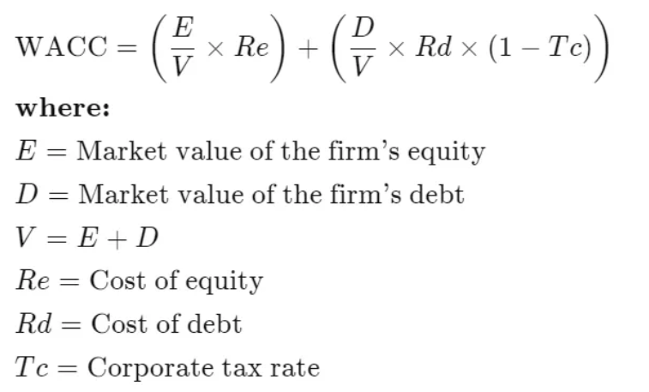

Contributions to the overall cost of capital
$$\frac{D}{V}$$
is also known as the leverage ratio and conveys the risk of debt default, leverage ratios are typically in the 50-70% range for energy projects

Slide 24
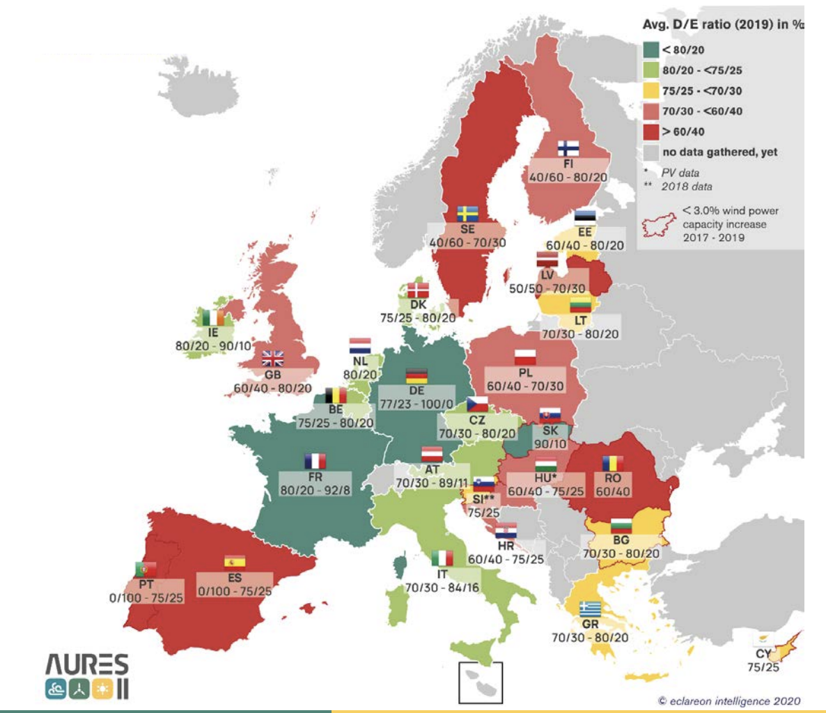
Contributions to the overall cost of capital
As discussed in Lecture 4, the capital structure of renewables varies but is typically close to 80:20 Debt to Equity split
Between countries, the Debt to Equity ratio for renewable investments varies widely
Countries perceived as risky typically have reduced debt shares (though other factors affect this)

Slide 25
Contributions to the overall cost of capital
Other factors that affect D-E ratios are interest rates, market actor type, and whether it is on- or off-balance sheet financing
Higher levels of debt typically reduce the cost of capital, as:
Debt is available at a lower cost than equity
Interest repayments to banks are exempt from tax

Slide 26
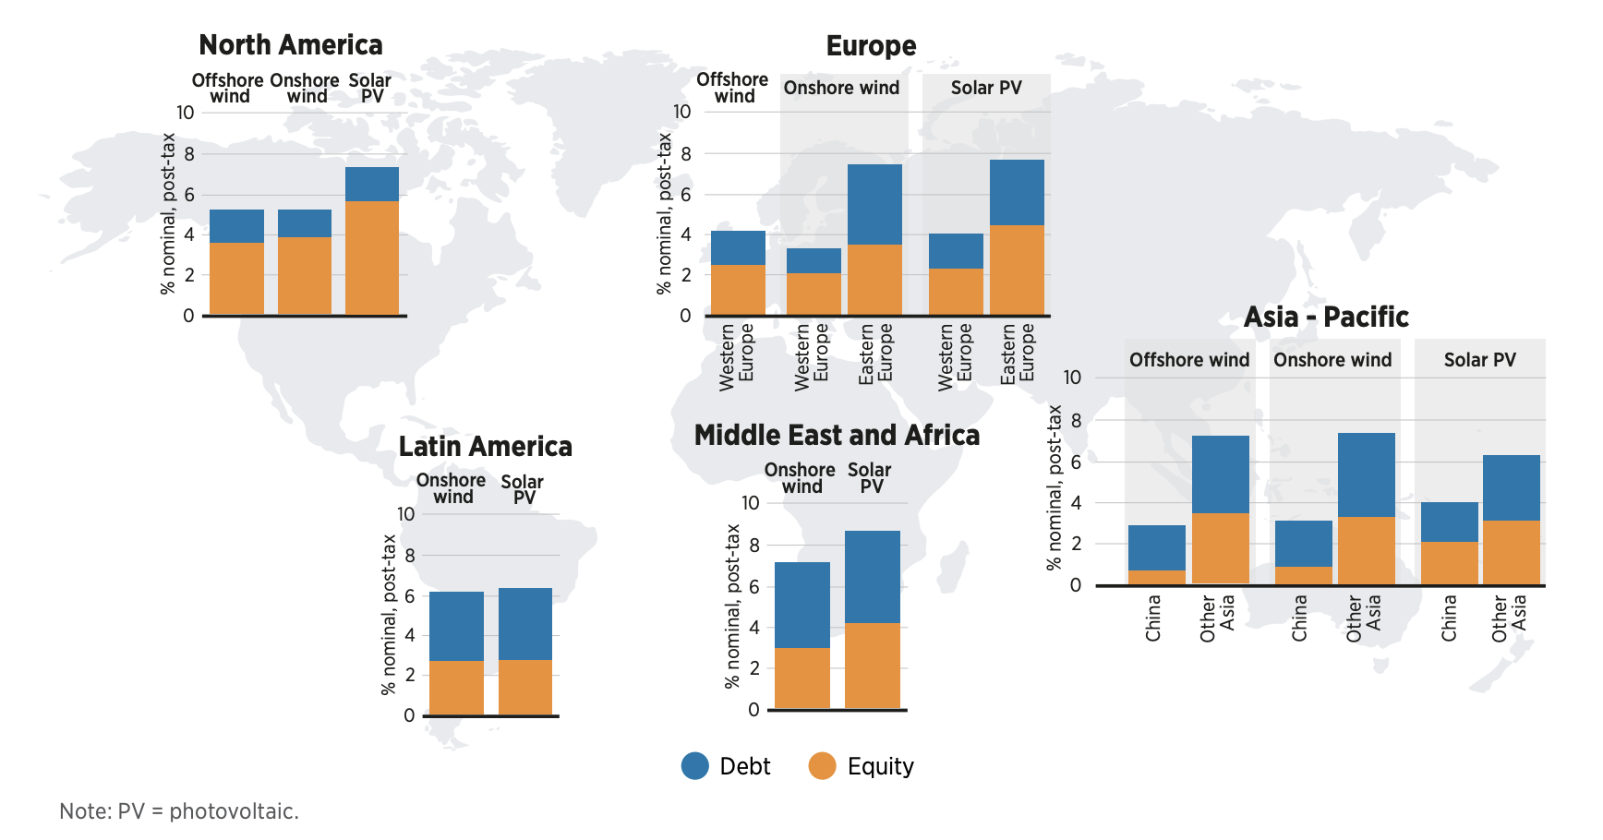
Contributions to the overall cost of capital
Geographically varying D-E splits and the cost of equity and debt combine to give different costs of capital between regions

Slide 27
Thank you
Contact Information: v.foster@imperial.ac.uk or hannah.luscombe@ouce.ox.ac.uk

